Slide 1

NDMA CUAS Specialist Course – System Information

Slide 2
System Overview - Introduction
In this module we are going to look at the following areas:
In depth view of System connections
In depth view of the Viper/Payload connections
IP address ranges of components
Container Power connections and Distribution Panel
Notes:
We looked at individual components in the Operator Section, this goes further into the system make up to provide further system knowledge.

Slide 3
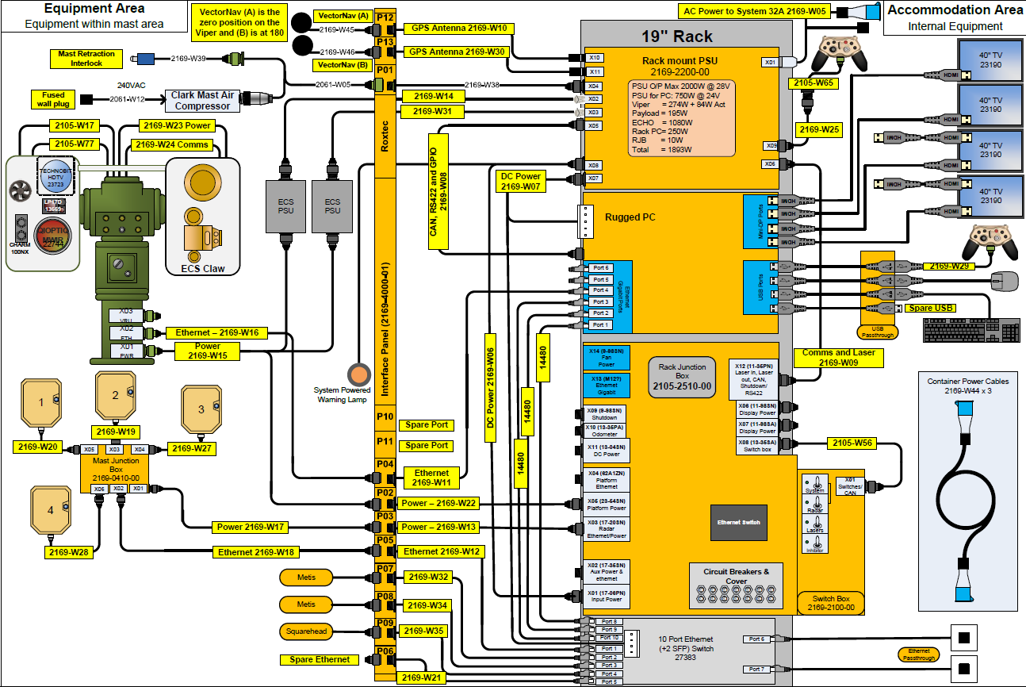
System Overview – Block Diagram
Notes:
Extra User Ethernet ports can be used to connect Square head or Metis toughbooks if desired.

Slide 4

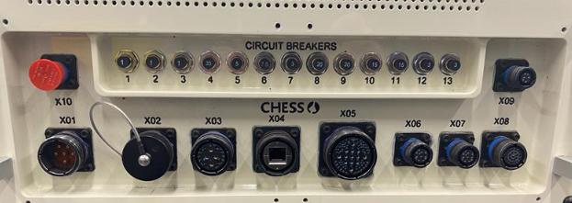
System Overview – Internal: RJB Front Panel Connections
Notes:
X01 is your main power input to the system, this is Fed from the PSU. This is 28Vdc
X03 carries your Radar power and Ethernet
X05 Provides Power to platform and payloads.
X08 Interconnection to the Control Switch box

Slide 5
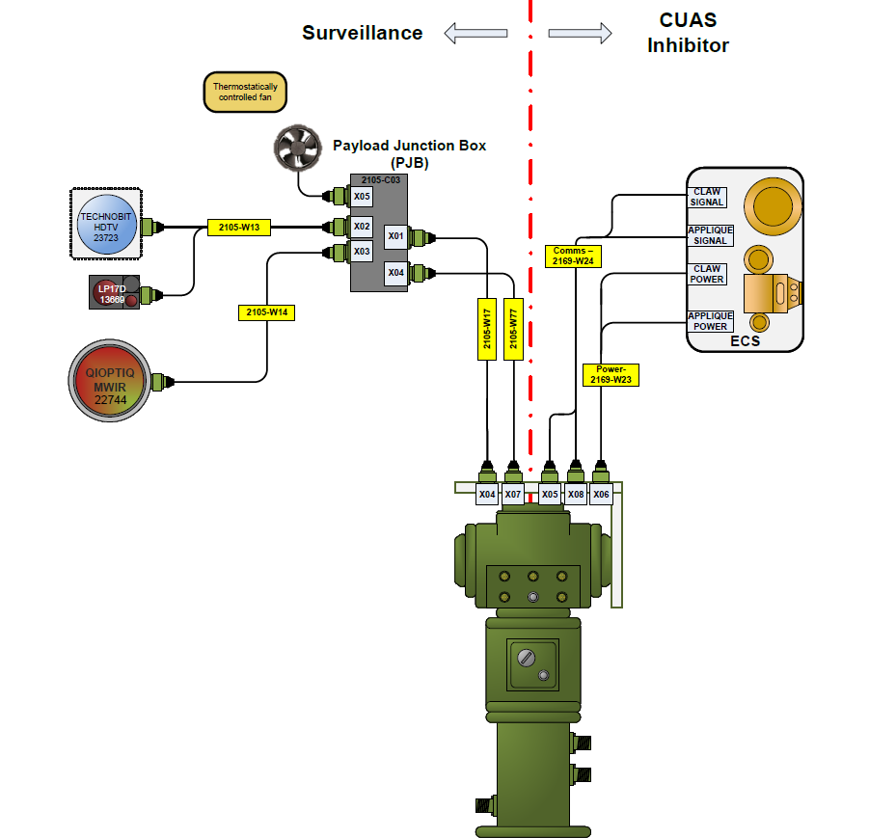
System Overview – EOD Block Diagram

Slide 6
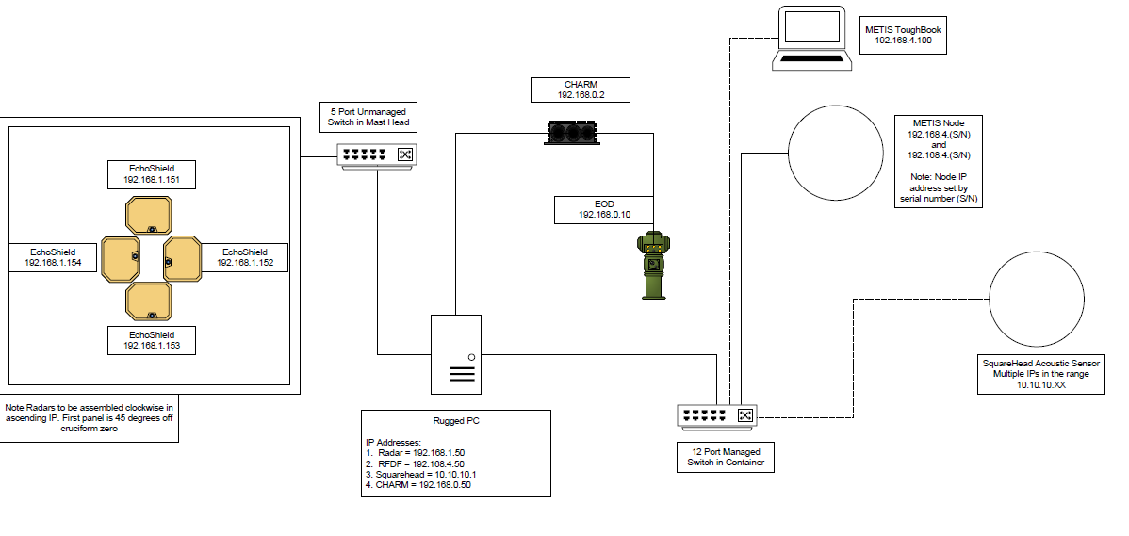
System Overview – IP System Architecture

Slide 7
System Overview – IP Address Ranges – Rugged PC
These are the IP address used by the Rugged PC in the system, these are fixed and any changes could result in render parts of the system inoperable.
Care should be taken that other devices attached to the NW do not conflict with these addresses.
Address | Use
192.168.1.50 | Radar IP Access
192.168.4.50 | Metis RFDF Access
10.10.10.1 | Squarehead Access
192.168.0.50 | VMS Charm Access

Slide 8
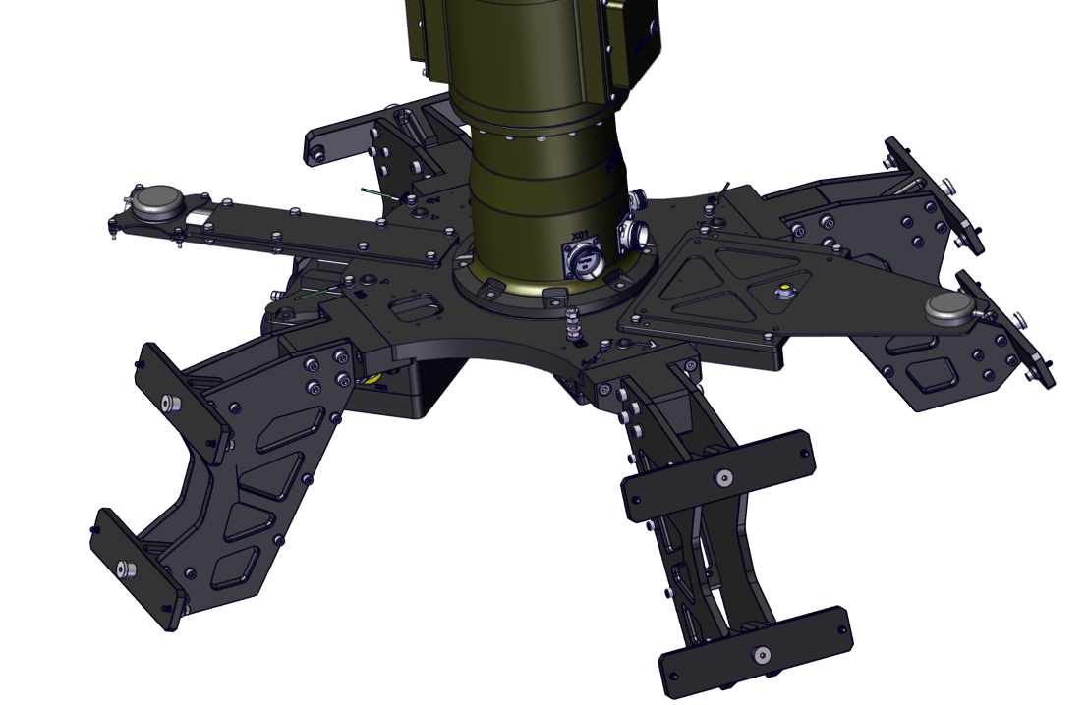
System Overview – IP Address Ranges – EchoShield Radars
These address are static and dependant on where the Radar is fitted in the system.
Radars are addresses clockwise in ascending IP. First panel is 45 degrees off cruciform zero
Care should be taken that other devices attached to the NW do not conflict with these addresses.
4
1
Address | Use
192.168.1.151 | Radar 1 (45 from 0)
192.168.1.152 | Radar 2 (135 from 0)
192.168.1.153 | Radar 3 (225 from 0)
192.168.1.154 | Radar 4 (315 from 0)
3
2
Care should be taken that other devices attached to the NW do not conflict with these addresses.

Slide 9
System Overview – EchoShield Radars - Azimuth Transmission Overlap
Azimuth transmission overlap diagram

Slide 10
System Overview – IP Address Ranges – Metis RFDF
These are the IP address used by the Metis RFDF in the system, these are fixed on the nodes and any changes could result in render parts of the system inoperable.
Generally, the system would have 2 nodes connected, but more could be networked into the system dependant on needs. The system is designed to look for any nodes within the 192.168.4.X range and connect to them..
Metis Address is dependent on the serial number of the systems in use, these are clearly marked on the units.
Address | Use
192.168.4.(S/N) | Metis RFDF Address Range
Care should be taken that other devices attached to the NW do not conflict with these addresses.

Slide 11
System Overview – IP Address Ranges – Squarehead
These are the IP address used by the SquareHead system, these are set on the nodes.
Generally, the system would have 4 nodes connected, but more could be networked into the system dependant on needs
More nodes can be added into the system, the CMS will just look for any within the 10.10.10.X address range
Metis Address is dependent on the serial number of the systems in use, these are clearly marked on the units.
Address | Use
10.10.XX.XX | Squarehead Address Range
Care should be taken that other devices attached to the NW do not conflict with these addresses.

Slide 12
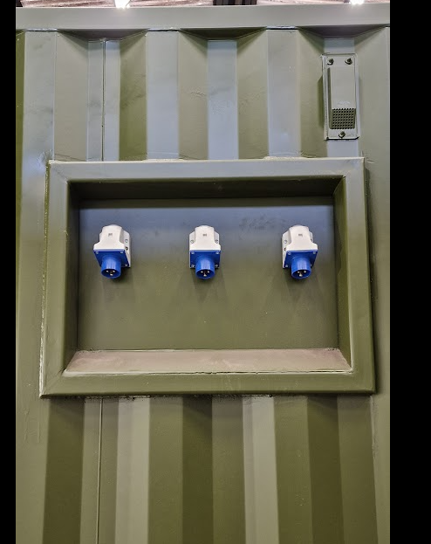
System Overview – AC Power and Consumer Unit
The Electrical Consumer unit distributes AC Power to the container.
Power is split across 3 separate inputs to distribute the load of the system. These connections are on the external of the container
1
2
3

Slide 13
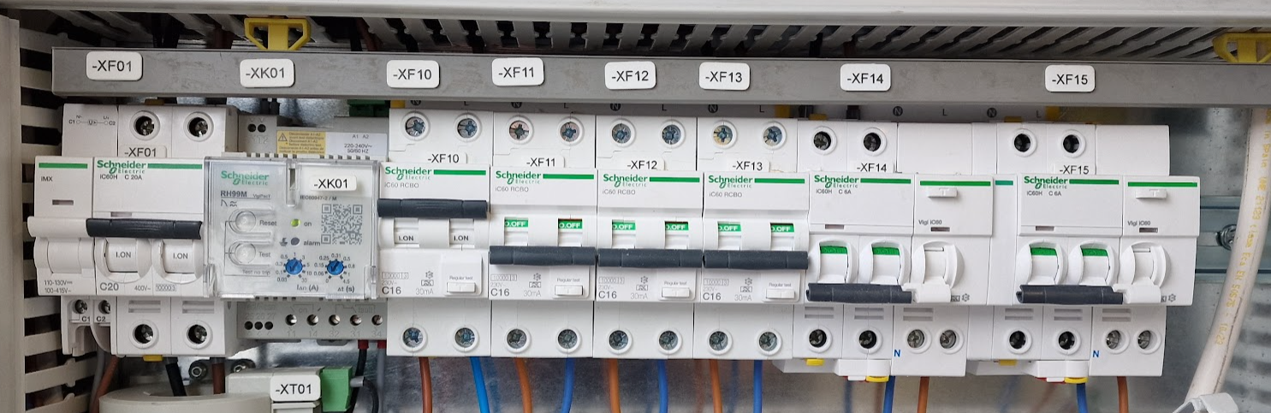
System Overview – AC Power and Consumer Unit
These set of circuit breakers are Fed from Supply 1 on the external of the container
Breaker | Use
XF01 | Incoming power
XF10 | Mast Compressor unit
XF11 | External Service Outlet
XF12 | External Service Outlet
XF13 | 2 x Single Plugs
XF14 | Fuel Gauge
XF15 | External Lighting

Slide 14
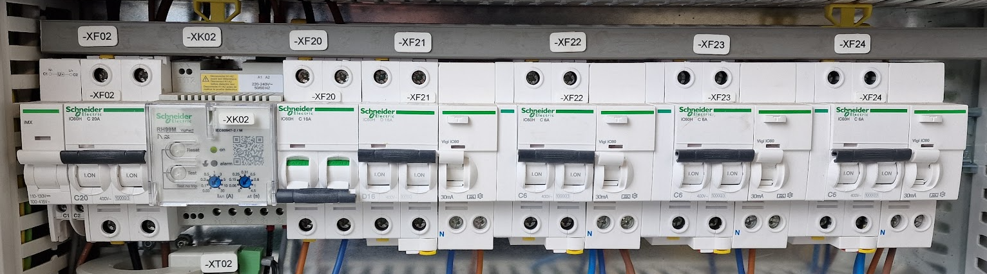
System Overview – AC Power and Consumer Unit
These set of circuit breakers are Fed from Supply 2 on the external of the container
Breaker | Use
XF02 | Incoming power
XF20 | UPS (Future expansion)
XF21 | 32A outlet for PSU
XF22 | Double sockets behind rack and user plugs
XF23 | Smoke and Co2 Sensors
XF24 | Internal Lighting
Notes:
AC2 inlet is probably the most important, as without this feed nothing will work.

Slide 15
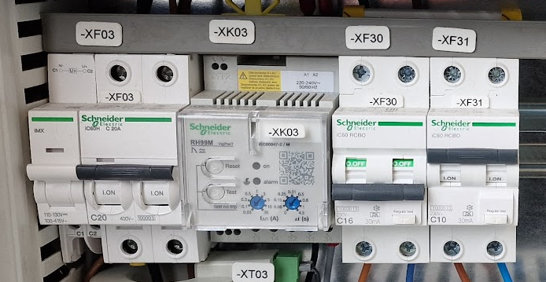
System Overview – AC Power and Consumer Unit
These set of circuit breakers are Fed from Supply 3 on the external of the container
Breaker | Use
XF03 | Incoming power
XF30 | Aircon unit
XF31 | 2 X TV and Fused switch
XF23 | Smoke and Co2 Sensors
XF24 | Internal Lighting
Notes:
XF31, the fused switch provides power to the RF Jamming system.

Slide 16
System Overview – RF Defeat Safety
Questions?

Slide 17
Blank Slide Template - Slide Title
Additional Information

